Slide 1
Social Sciences and Humanities for Advancing Energy and Climate Policies
Görkem Güngör
E-mail: ggungor@hacettepe.edu.tr

Slide 2
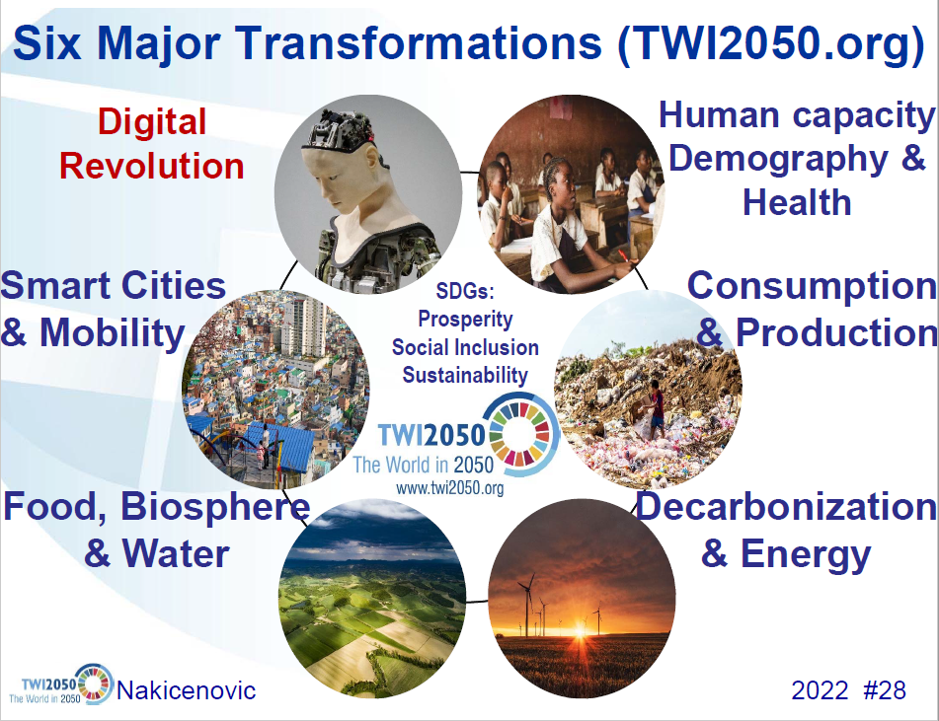
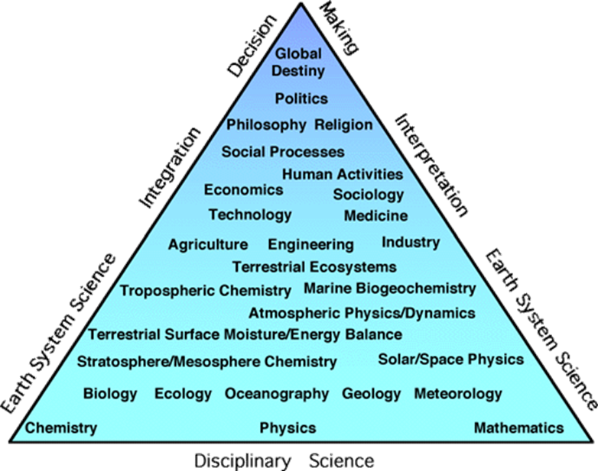

Setting the Scene
Since the industrial revolution, the human impact on the earth's system is on the same magnitude as natural forcings
Need for a paradigm shift from a techno-centric to a human-centric approach
There are synergies for inter-disciplinary studies where mutual collaboration pays off better than individual efforts
However, there are also trade-offs with individualism and care ethics as human society moves to a cyber-space
How we mitigate these trade-offs and increase the synergies to solve global problems is up to you
Notes:
https://www.iamconsortium.org/event/iamc-webinar-15-years-of-community-and-science-agenda-building-from-emissions-scenarios-to-the-transformative-change-nebojsa-nakicenovic/

Slide 3
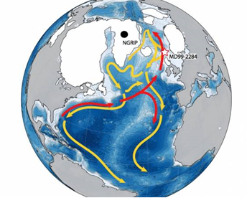
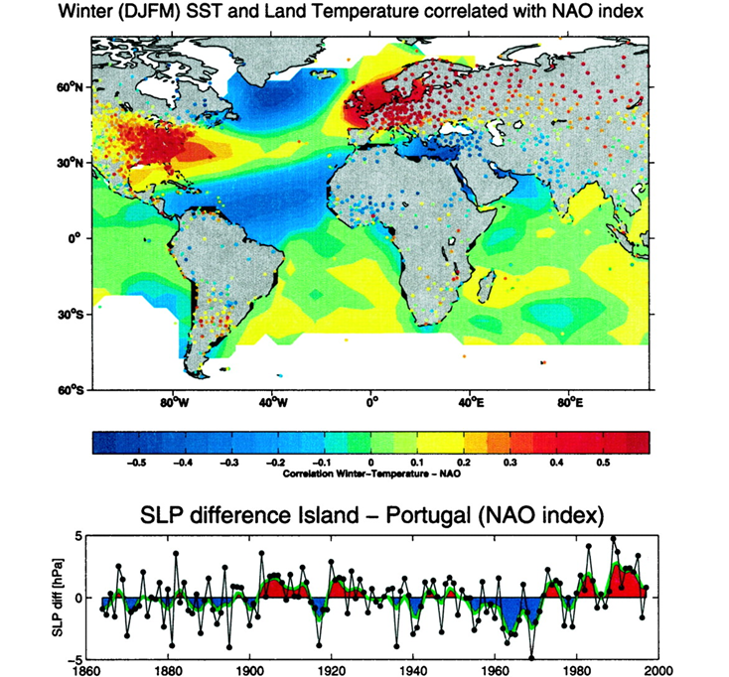
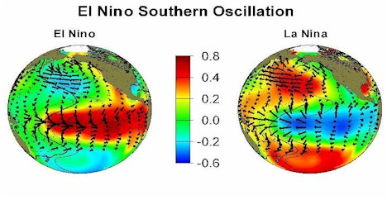
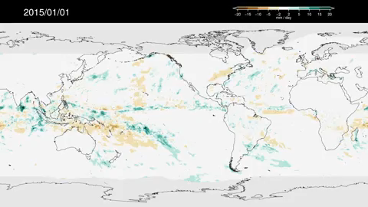
The Natural Cycles
Ethical dilemma between the agent and the patient:
Who is the agent?
How can one be so sure?
2015-2016 El Niño:
Shift of rainfall from the western Pacific
Drier conditions in the Caribbean, tropical Atlantic, and northern South America
North Atlantic Oscillation (NAO) might have played a role in regulating the temperature and precipitation in the Mesopotamian region
The retreat of sea ice in the Arctic Ocean might have an impact on the NAO cycle
Notes:
https://svs.gsfc.nasa.gov/13347
Visbeck MH, Hurrell JW, Polvani L, Cullen HM. The North Atlantic Oscillation: Past, present, and future. Proc Natl Acad Sci [Internet]. 2001. 98(23):12876–7.
Pedersen RA, Cvijanovic I, Langen PL, Vinther BM. The Impact of Regional Arctic Sea Ice Loss on Atmospheric Circulation and the NAO. J Clim [Internet]. 2016. 29(2):889–902.

Slide 4
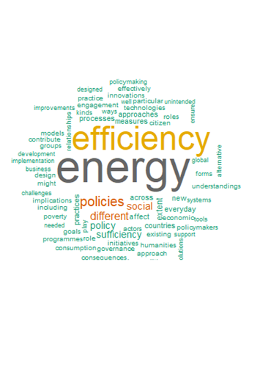
Research Questions
Social Sciences and Humanities (SSH) may support the synergies and mitigate the trade-offs when used to set new research agendas
Horizon scanning involves a "core group" of inter-disciplinary researchers aiming to "co-create" research agendas
Policy recommendations should touch the "daily lives" - otherwise lost in user behavior
Energy efficiency and SSH:
Energy security (the 1970s)
Environmental and climate protection (since the 1980s)
Citizenship, engagement and knowledge exchange
Equity, justice, poverty and vulnerability
Everyday life and practices of energy consumption and production
Framing, defining and measuring
Roles of economic systems, supply chains and financial mechanisms
Governance, policy and political issues
The interactions, unintended consequences and rebound effects
Notes:
Foulds C, Royston S, Berker T, Nakopoulou E, Bharucha ZP, Robison R, et al. An agenda for future Social Sciences and Humanities research on energy efficiency: 100 priority research questions. Humanit Soc Sci Commun. 2022. 9(1).
https://energy-shifts.eu/what-is-horizon-scanning/

Slide 5
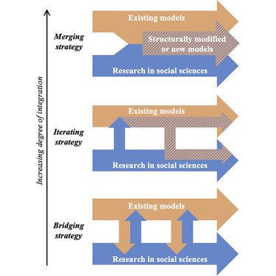
Societal Transformations in Energy and Climate Models
Most models focus on technology, environment, economy and policy
Increasing integration provides synergies between disciplines and trade-offs with the oversimplification of social drivers
Merging strategy increases synergies with:
Mapping behavior and lifestyle assumptions for sectoral transition
Identifying the missing elements in scenario storylines
Societal capacities to take bold actions (e.g. phase out coal) and align the administration
Energy and climate models may be modified considering the strategies for merging SSH
What about the modeler and the model bias?
Notes:
Trutnevyte E, Hirt LF, Bauer N, Cherp A, Hawkes A, Edelenbosch OY, et al. Societal Transformations in Models for Energy and Climate Policy: The Ambitious Next Step. One Earth [Internet]. 2019. 1(4):423–33.

Slide 6
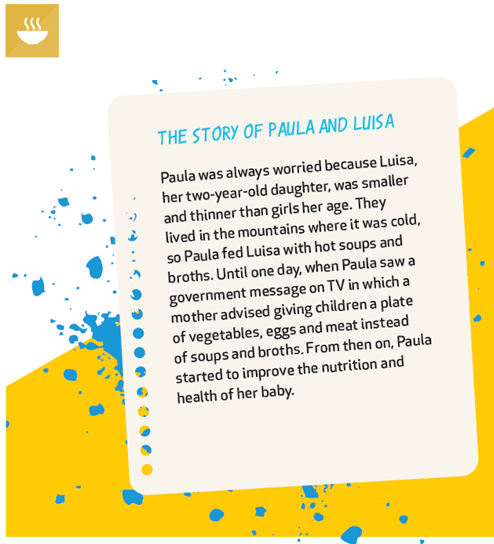
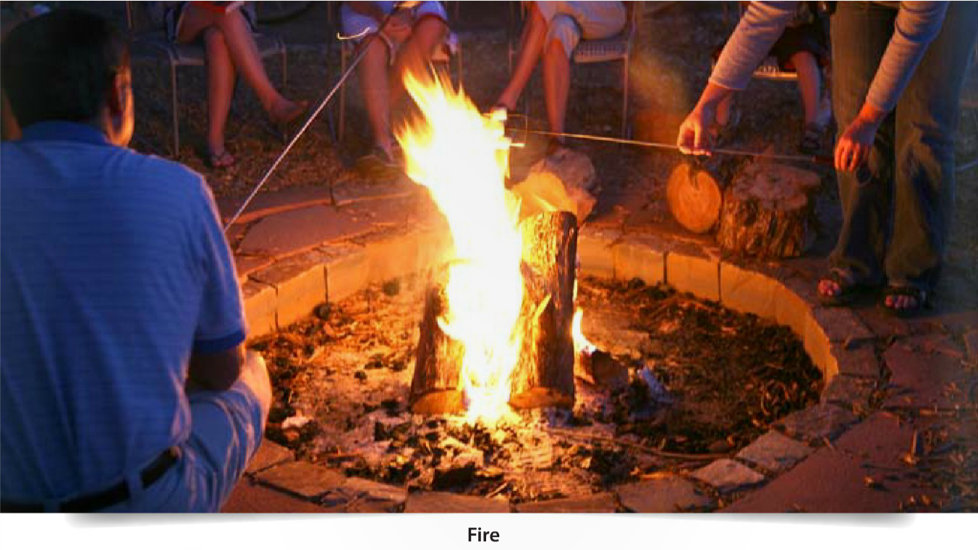
Storytelling for Inclusive Energy and Climate Policy
Stories with a focus on climate emergency
Persuasive: concensus for action (The Hare and the Turtoise)
Learning: avoid future mistakes (The Pied Piper of Hamelin)
Personal: create oral history (Epic of Manas)
The results of multi-stakeholder workshops:
Increasing intimitacy before negotation through storytelling
Mitigate the domination relationships
Government-civilian
Teacher-student
Gender?
Collaborative story writing for conflict solving
Notes:
Mourik RM, Sonetti G, Robison RAV. The same old story – or not? How storytelling can support inclusive local energy policy. Energy Res Soc Sci [Internet]. 2021. 73(November 2020):101940.

Slide 7

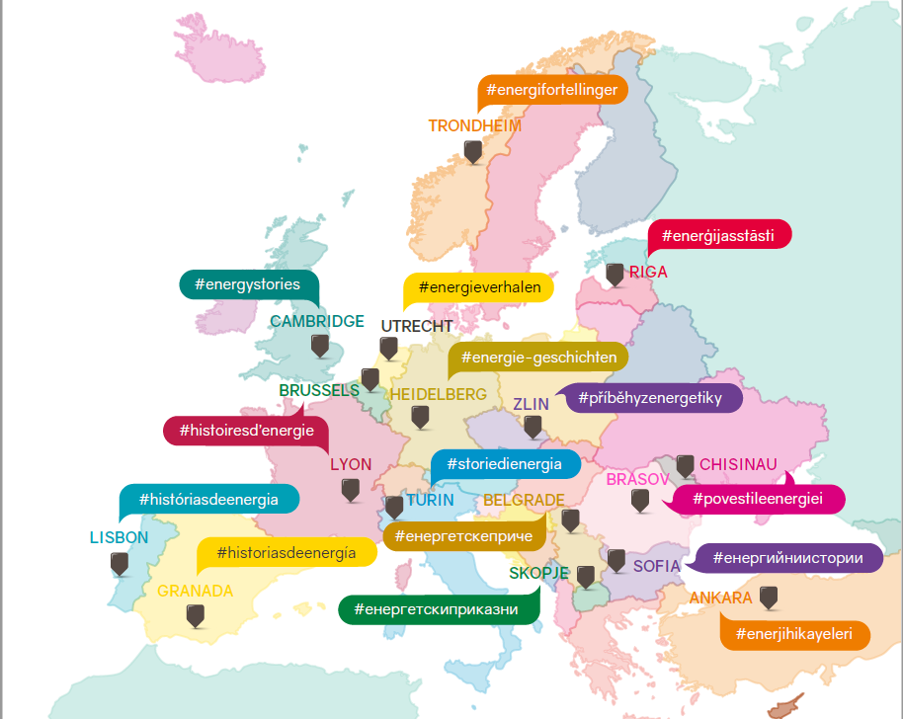

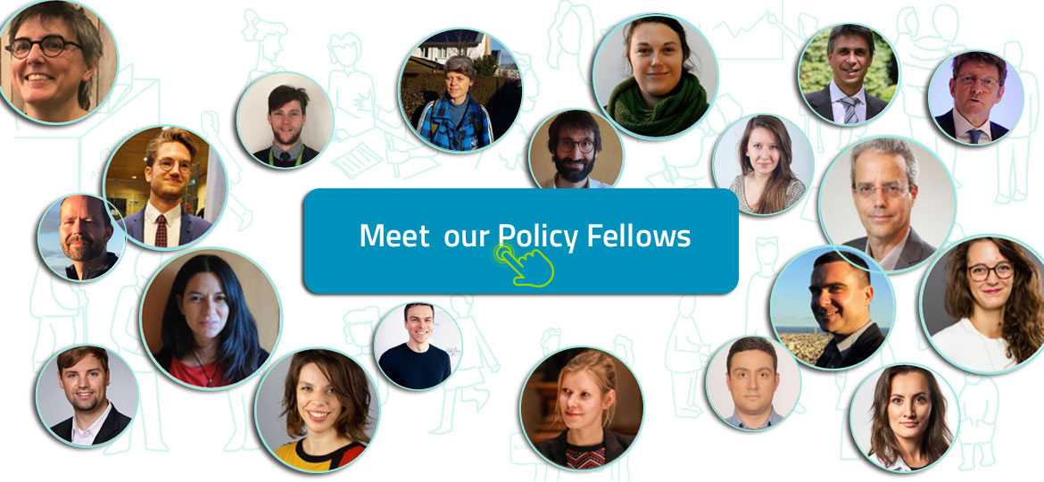
European Union Research Calls
EU Projects for implementing SSH actions supporting EU Green Deal
Projects involved multi-stakeholder workshops in major cities including Ankara (METU)
Workshops involved representatives from government, NGOs, business, university and citizens
Social themes identified in workshops:
Changing energy behaviours
Energy education and engagement
Vision, inclusivity and fairness
Energy collaborations
Creating alternative systems
Timescales of energy systems
Notes:
Robison, R., Dupas, S., Mourik, R., Torres, M., and Milroy, E., 2018. Europe’s local energy challenges: stories and research priorities from 17 multi-stakeholder city workshops. Cambridge: SHAPE ENERGY.
https://www.youtube.com/watch?v=tVVkz6fy7-s

Slide 8

Changing Energy Behaviours
Everybody wants change but it doesn’t happen, or the results aren’t satisfactory.
How can we make sure that behaviour change leads to less consumption?

Slide 9
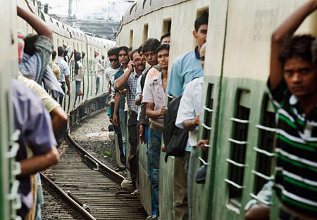

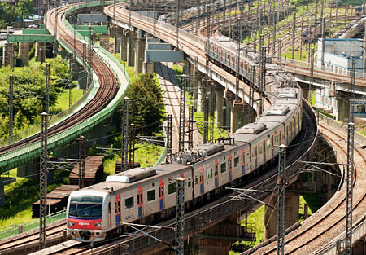

Energy Education and Engagement
Education increases knowledge but doesn’t produce changes in attitudes or actions
How can we engage citizens, who are price takers and consumers, to the energy system?

Slide 10
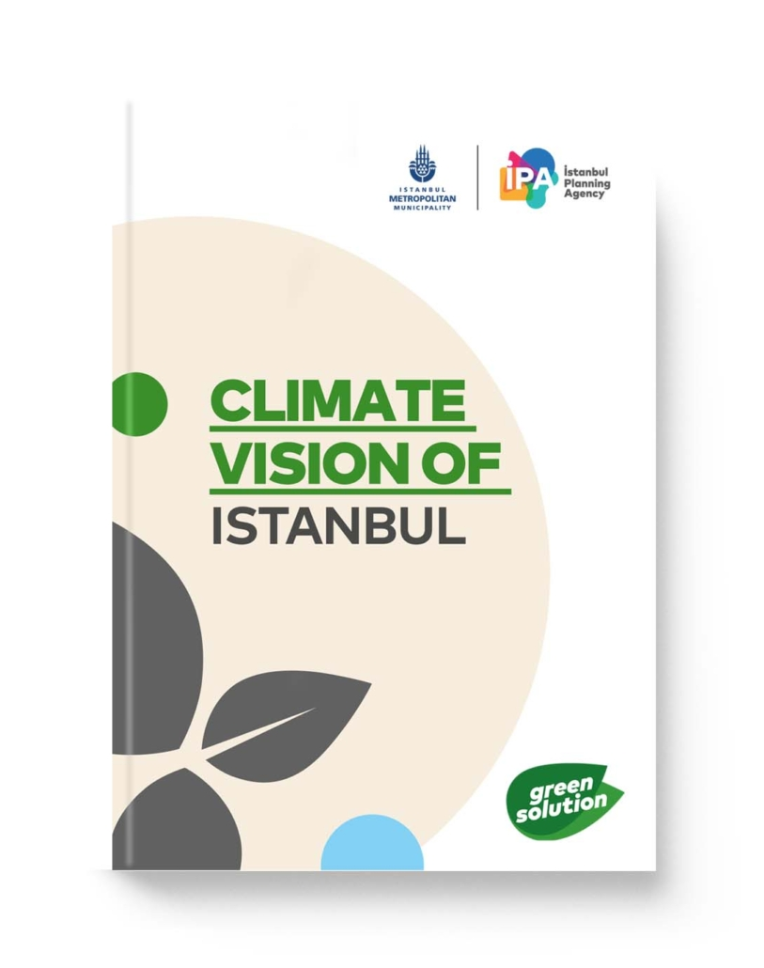
Vision, Inclusivity and Fairness
A shared vision at the local level (community) could support change
How can we trust each other so we don’t just blame others in case of failure?
Notes:
https://ipa.istanbul/en/yayin/climate-vision-of-istanbul/

Slide 11
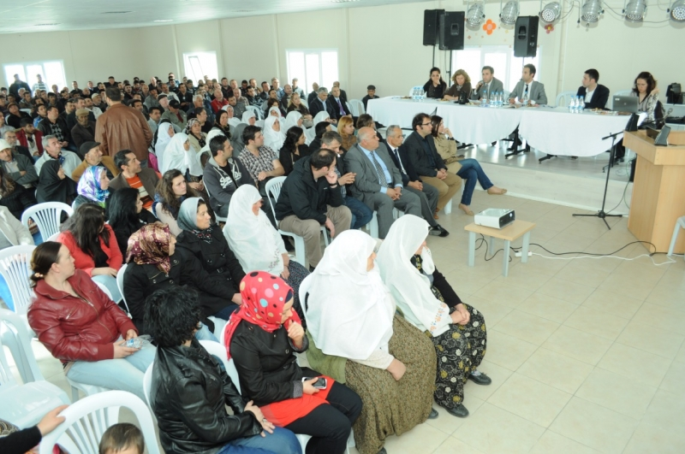
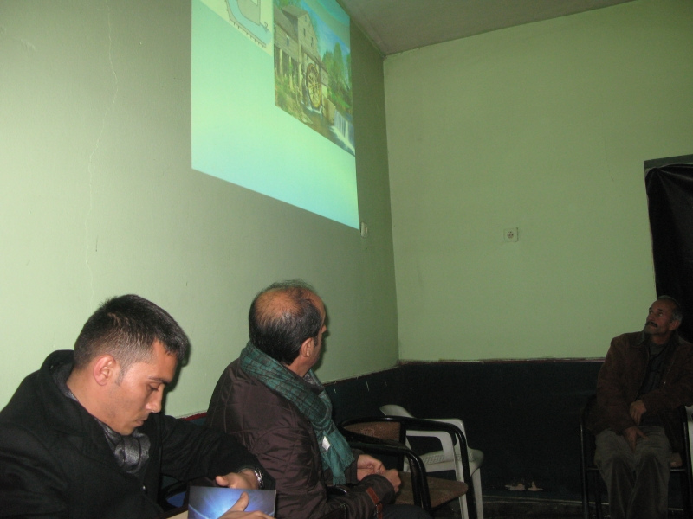
Energy Collaborations
Collaboration requires the promotion of synergies and mitigation of trade-offs between actors with diverging interests
How can we trust each other and override our conflicting interests?

Slide 12
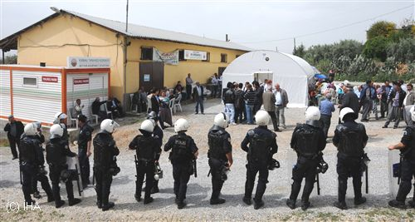
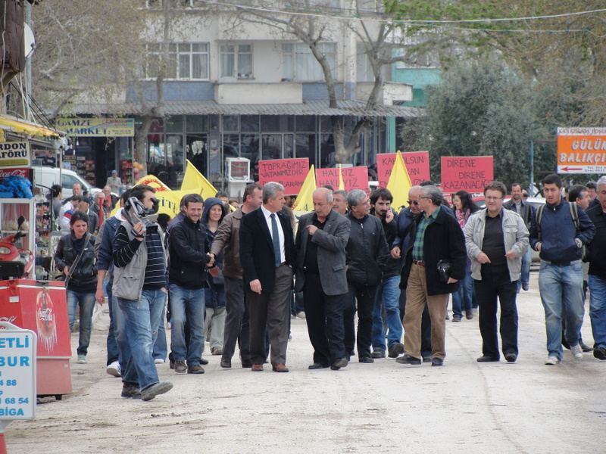
Creating Alternative Systems
Energy transition will move our existing infrastructure to obsolete and require cleaning up
How can we deal with the social tensions which could arise from cleaning up?

Slide 13
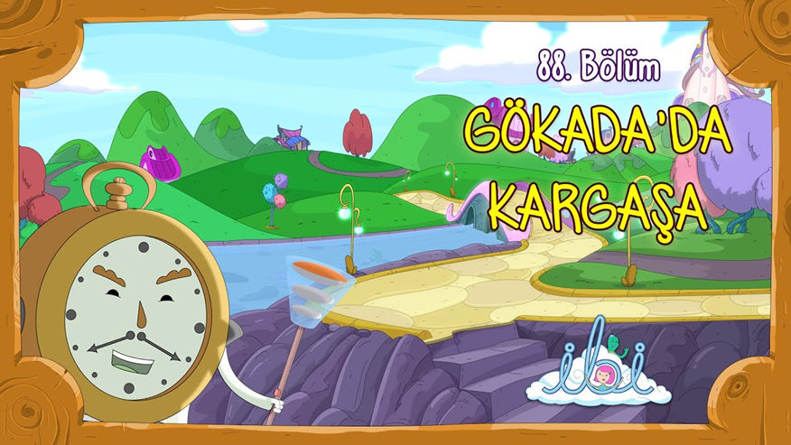

Timescales of Energy Systems
Long term targets require clear milestones and a common vision at the local level
Could slowing down be a remedy for our problems?

Slide 14
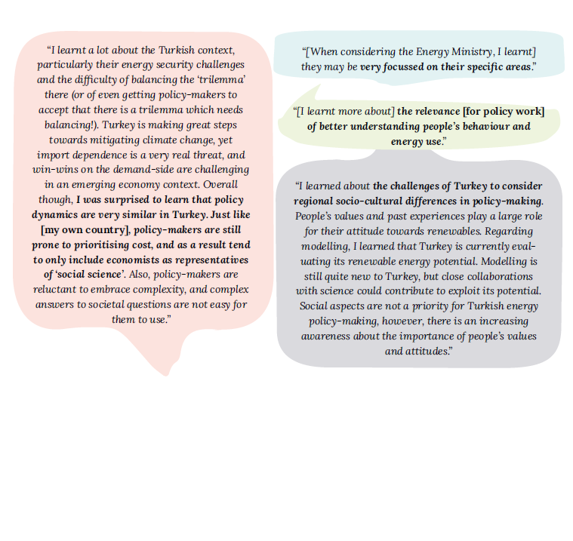
Energy Policy Fellowships
Matching of energy policy fellows with SSH researchers
Interviews focusing on the work of fellows and SSH-related policy challenges
Some examples for citizen engagement:
Electricity transmission system operator’s forecasting exercise (France)
Public engagement in energy policy (Israel)
Urban citizen engagement (Serbia)
Incorporating citizens’ values into energy policy decisions (Turkey)
Designing effective dialogue processes (Netherlands)
Social Acceptance
Just Transitions
Human Capital
Citizen Engagement
Behaviours
Anglia Ruskin University
Jagiellonian University
Dutch Research Institute for Transitions
EERA/Tecnalia
Norwegian University of Science and Technology
Notes:
de Geus, T., Bode, N., Robison, R., Rohse, M., Foulds, C., Wagner, A., Krupnik, S., Świątkiewicz-Mośny, M., Rudek, T., Kuittinen, H. Lisi, V., Søraa, R., Lunevich, I., Wittmayer, J. 2020. Shifting perspectives: insights from the Energy Policy Fellowships. Cambridge: Energy-SHIFTS.

Slide 15
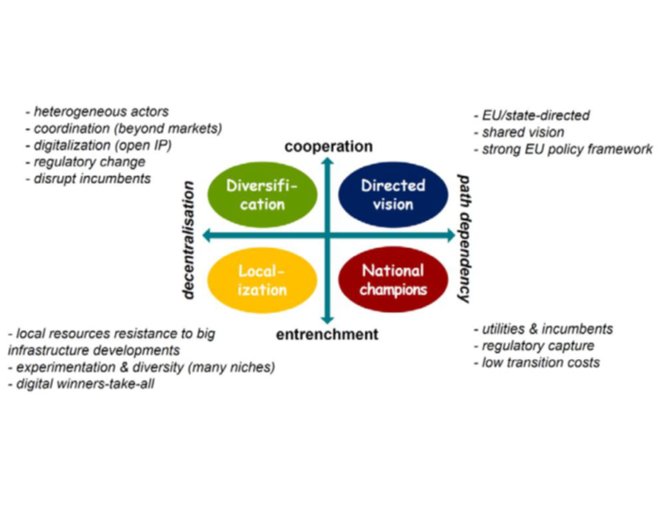
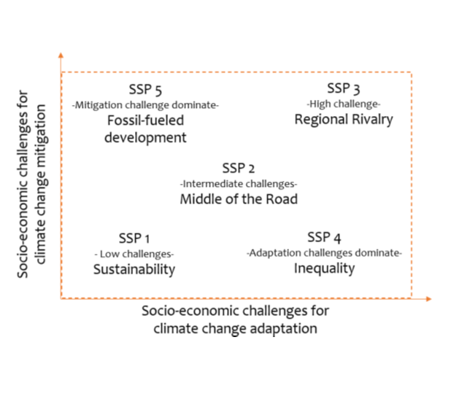
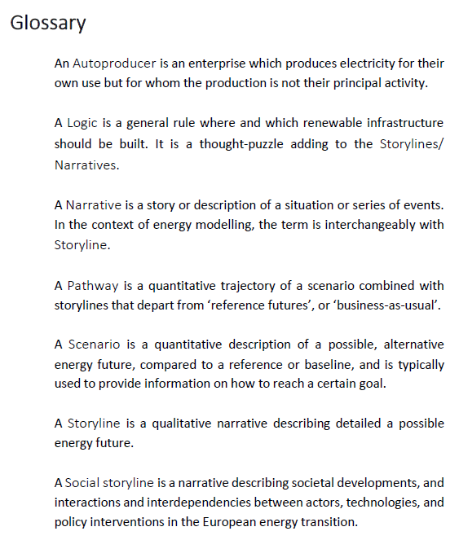
Linking Social Science and Energy Models
Energy models are useful for ex-ante analysis of transition
Current storyline approaches:
Narratives for SSPs
OpenENTRANCE storylines
Set-Nav pathway storylines
Storylines informed by multi-level perspective (technological substitution vs. broader change)
Two general assumptions for storylines:
Climate neutrality by 2050 or before
Citizen awareness for climate change
Notes:
Süsser, D., al Rakouki, H., Lilliestam, J. (2021): The QTDIAN modelling toolbox–Quantification of social drivers and constraints of the diffusion of energy technologies. Deliverable 2.3. Sustainable Energy Transitions Laboratory (SENTINEL) project, Potsdam : Institute for Advanced Sustainability Studies (IASS), 94 p.

Slide 16
References
[1] Visbeck MH, Hurrell JW, Polvani L, Cullen HM. The North Atlantic Oscillation: Past, present, and future. Proc Natl Acad Sci [Internet]. 2001. 98(23):12876–7.
[2] Pedersen RA, Cvijanovic I, Langen PL, Vinther BM. The Impact of Regional Arctic Sea Ice Loss on Atmospheric Circulation and the NAO. J Clim [Internet]. 2016. 29(2):889–902.
[3] Foulds C, Royston S, Berker T, Nakopoulou E, Bharucha ZP, Robison R, et al. An agenda for future Social Sciences and Humanities research on energy efficiency: 100 priority research questions. Humanit Soc Sci Commun. 2022. 9(1).
[4] Trutnevyte E, Hirt LF, Bauer N, Cherp A, Hawkes A, Edelenbosch OY, et al. Societal Transformations in Models for Energy and Climate Policy: The Ambitious Next Step. One Earth [Internet]. 2019. 1(4):423–33.
[5] Mourik RM, Sonetti G, Robison RAV. The same old story – or not? How storytelling can support inclusive local energy policy. Energy Res Soc Sci [Internet]. 2021. 73(November 2020):101940.
[6] Robison, R., Dupas, S., Mourik, R., Torres, M., and Milroy, E., 2018. Europe’s local energy challenges: stories and research priorities from 17 multi-stakeholder city workshops. Cambridge: SHAPE ENERGY.
[7] de Geus, T., Bode, N., Robison, R., Rohse, M., Foulds, C., Wagner, A., Krupnik, S., Świątkiewicz-Mośny, M., Rudek, T., Kuittinen, H. Lisi, V., Søraa, R., Lunevich, I., Wittmayer, J. 2020. Shifting perspectives: insights from the Energy Policy Fellowships. Cambridge: Energy-SHIFTS.
[8] Süsser, D., al Rakouki, H., Lilliestam, J. (2021): The QTDIAN modelling toolbox–Quantification of social drivers and constraints of the diffusion of energy technologies. Deliverable 2.3. Sustainable Energy Transitions Laboratory (SENTINEL) project, Potsdam : Institute for Advanced Sustainability Studies (IASS), 94 p.

